Slide 1


Team 22: Solar Home Lighting
Bi-Weekly Update 2 Jack Holdridge
Kyle Walcher
Matthew Greer
Adam Garcia
TA: Guanhua Tao
Sponsor: Won Jang
Notes:
Michelle

Slide 2
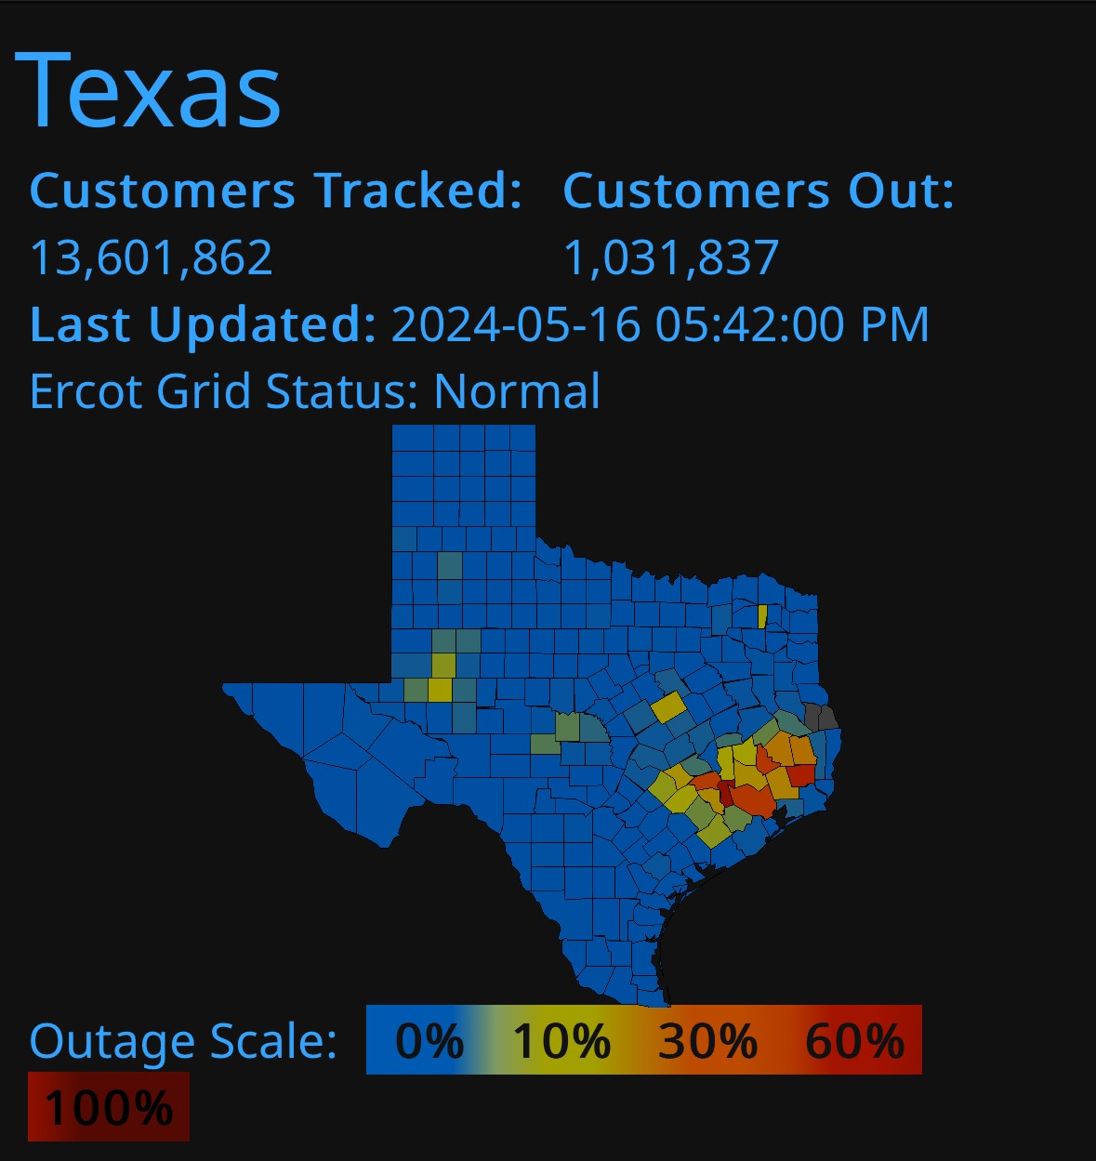
Project Summary
Problem statement:
Modern residential smart-home solutions are fragmented, relying on multiple standalone devices from different vendors that depend heavily on continuous power and cloud connectivity. During power outages or grid disturbances, these systems often fail to provide basic lighting and monitoring, leaving homeowners without reliable operation. Additionally, the cost, complexity, and maintenance burden of deploying and managing multiple independent systems create barriers to adoption, limit scalability, and may result in poor user experience.
Our Solution:
Combine security, lighting control, and user interaction into one coordinated platform
Offer flexible controls, with both local and remote capabilities.
Ensures the home remains safely lit and monitored regardless of grid fluctuations.
Notes:
Kyle

Slide 3
System Overview
Kyle Walcher
Adam Garcia
Solar panel
MPPT charge controller
Android Application
(Kotlin/Java)
3.3v Buck Converteri
12v deep cycle battery
OpenAI/Python Flask Server
ESP32-WROVER
Jack Holdridge
Matthew Greer
12v Buck Boost DC converter
3.3v Buck Converter
‹#›
Database
MCU
Touch screen HMI
ESP32
ESP32
Relay board and LED Lights
Sensors
Notes:
Eric

Slide 4
Project Timeline
Subsystem Designs updated and ready for integration (to complete 2/4/26) | Integration of Database with application (completed 1/28/26) | Integration of light controls with android application (to complete 2/11/26) | Final Integration (to complete 2/25/26) | System Test (to complete 3/4/26) | Validation of system (to complete 3/11/26) | Demo (to complete 4/15/26)
Notes:
Eric

Slide 5
MPPT Charge Controller Adam Garcia
Accomplishments since Status Update #1 18hrs of effort | Ongoing progress/problems and plans until the next presentation
Redesigned PCB Added MPPT IC and terminal block to support 2 batteries | Validate MPPT and Buck converter IC operation.

Slide 6
MPPT Charge Controller Adam Garcia
Issues addressed:
Input voltage regulation from solar panel, Vmp = 18V
LTC4015 MMPT IC with Buck Battery communication via I2C
Battery Charge protection
CC/CV

Slide 7
Physical Controls Jack Holdridge
Accomplishments since 403 14 hrs of effort | Ongoing progress/problems and plans until the next presentation
Confirmed 12v converter point of failure. Redesigned, ordered, and assembled updated 12v converter. Function tested 12v converter up to 3 amp stability. Updated Touchscreen code to provide improved UI. | Redesigned 12v converter validation. Design and assemble Physical Controls housing. Integrating the database and physical controls communication .

Slide 8
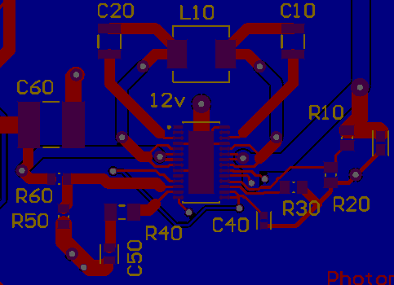
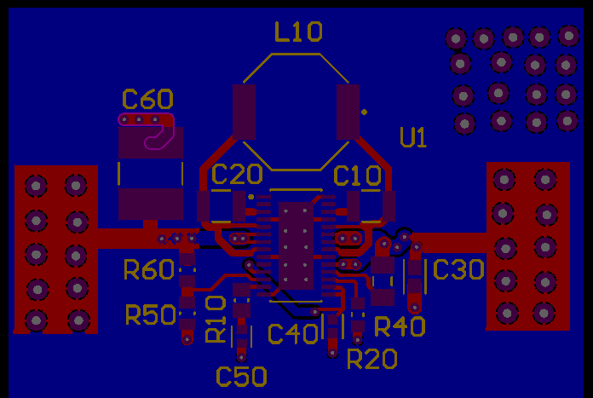
Physical Controls Jack Holdridge
12V Buck-Boost Converter: Changed to a 2 MHz wide input converter, and removed UVLO function that was causing performance issues.

Slide 9
Android Application and Camera Kyle Walcher
Accomplishments since last update 15 hrs of effort | Ongoing progress/problems and plans until the next presentation
Firebase Database Integration (Login, Snapshots, AI summaries) Universal Login capabilities (Forgot password, create account, user customization) Universal Snapshot Capability (Camera is accessible off of local wifi) | ESP-32 Camera & motion sensor enclosure Motion Sensor Logic to automatically trigger AI analysis Remote Lighting controls within application

Slide 10
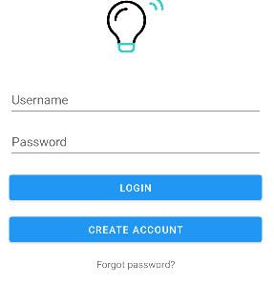
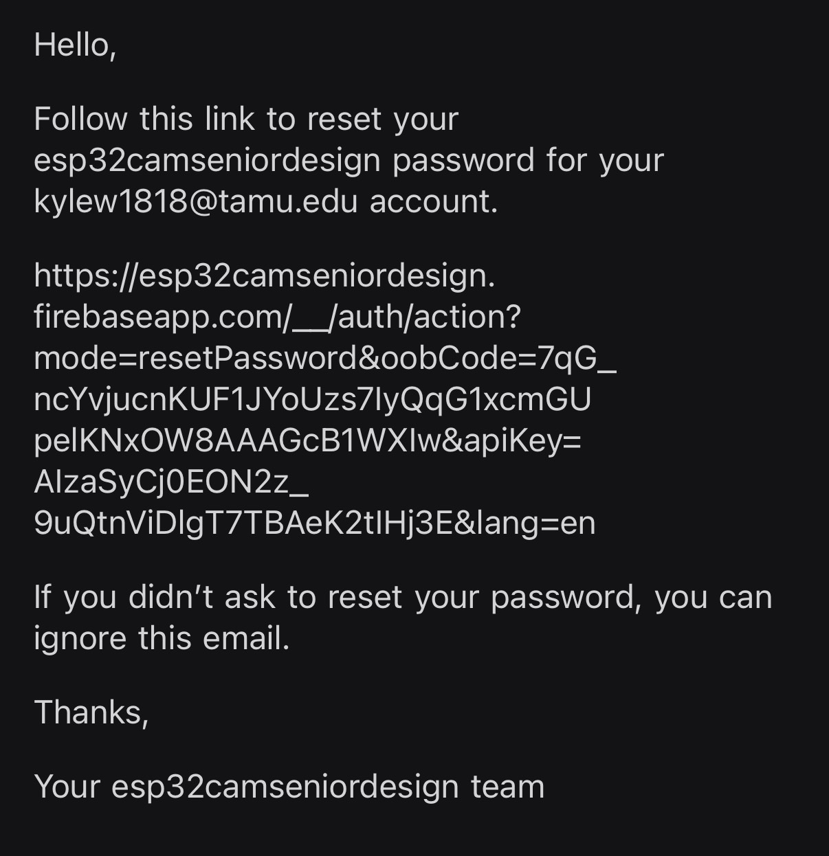
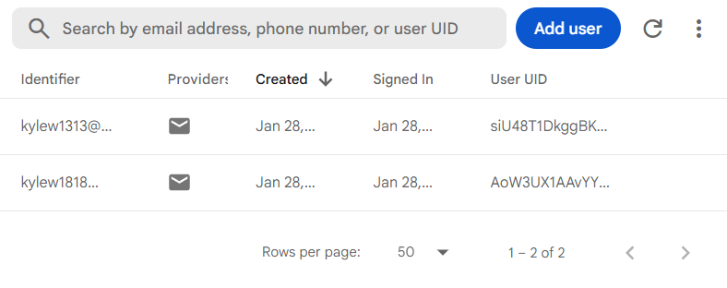
Android Application and Camera Kyle Walcher
Firebase Data integration
Each user has independent logins with snapshots, activity, and summaries time stamped and saved within firebase and in application.

Slide 11
MCU, Sensors & Database Matthew Greer
Accomplishments Update 15 Hours | Ongoing progress/problems and plans until the next presentation
Resolved MCU latency issues through task scheduling and prioritization Achieved reliable integration between MCU and cloud database Verified end-to-end data flow for sensor input, MCU logic, and database commands | Upgrade PIR motion sensors to reduce false triggers and improve detection reliability Integrate database control with mobile app interface Implement software-level integration between MCU and charge controller

Slide 12
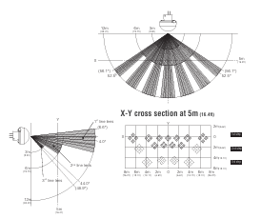
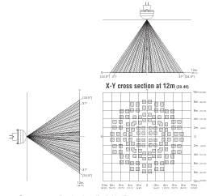
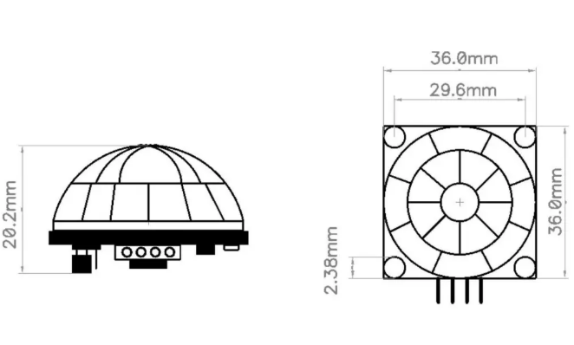


Current Sensor
Upgraded Sensors
Inside PIR
Outside PIR
Wide-angle PIR with adjustable sensitivity
Detects general motion but lacks controlled detection geometry
High false triggers from small or low-level motion
Short, controlled detection range (3–6 m) for indoor spaces
Detection zones angle above floor level to reduce pets/toddlers
Designed for presence detection, not long-distance tracking
High zone density (128 zones) for improved human motion discrimination
Long detection range (12–14.5 m) for approach detection
Triggers lighting and camera activation with low false alarms

Slide 13
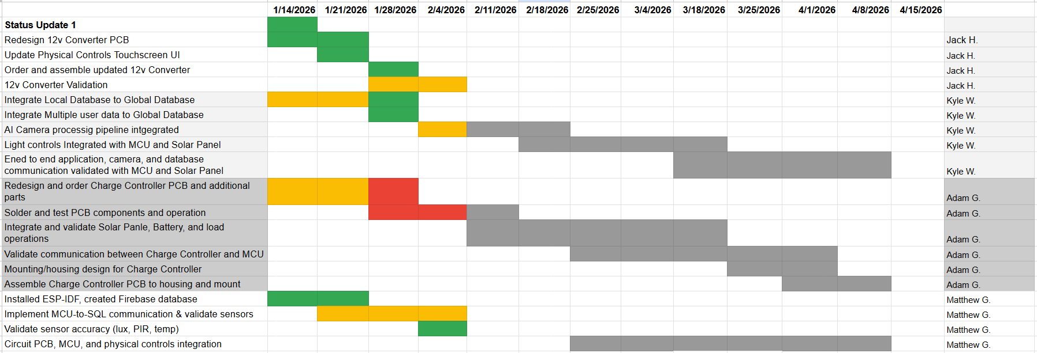
Execution & Plan
Notes:
Michelle

Slide 14
Solar Home Lighting 3:
Thank you for listening!
Questions?
Jack Holdridge
Kyle Walcher
Matthew Greer
Adam Garcia
TA: Guanhua Tao
Sponsor: Won Jang
‹#›

